Slide 1

North Carolina
Environmental Management Commission
Water Allocation Committee
Importance of Water Reuse by Orange Water and Sewer Authority
January 8, 2020

Slide 2

Chapel Hill/Carrboro, NC
Greensboro
Durham
Asheville
Raleigh
Charlotte
Fayetteville
Wilmington
Orange Water and Sewer Authority
OWASA is Carrboro-Chapel Hill’s not-for-profit public service agency delivering high quality water, wastewater and reclaimed water services.

Slide 3
Key Takeaways
Water reuse is an essential part of a “One-Water” management strategy
Science-based regulations should support and encourage water reuse. Reclaimed water is a resource, not a “waste”.
Existing NC regulations allow smart use of non-potable reuse
Opportunity to adopt science-based regulations in NC to support and encourage indirect and direct potable reuse – site specific considerations (flexibility)

Slide 4
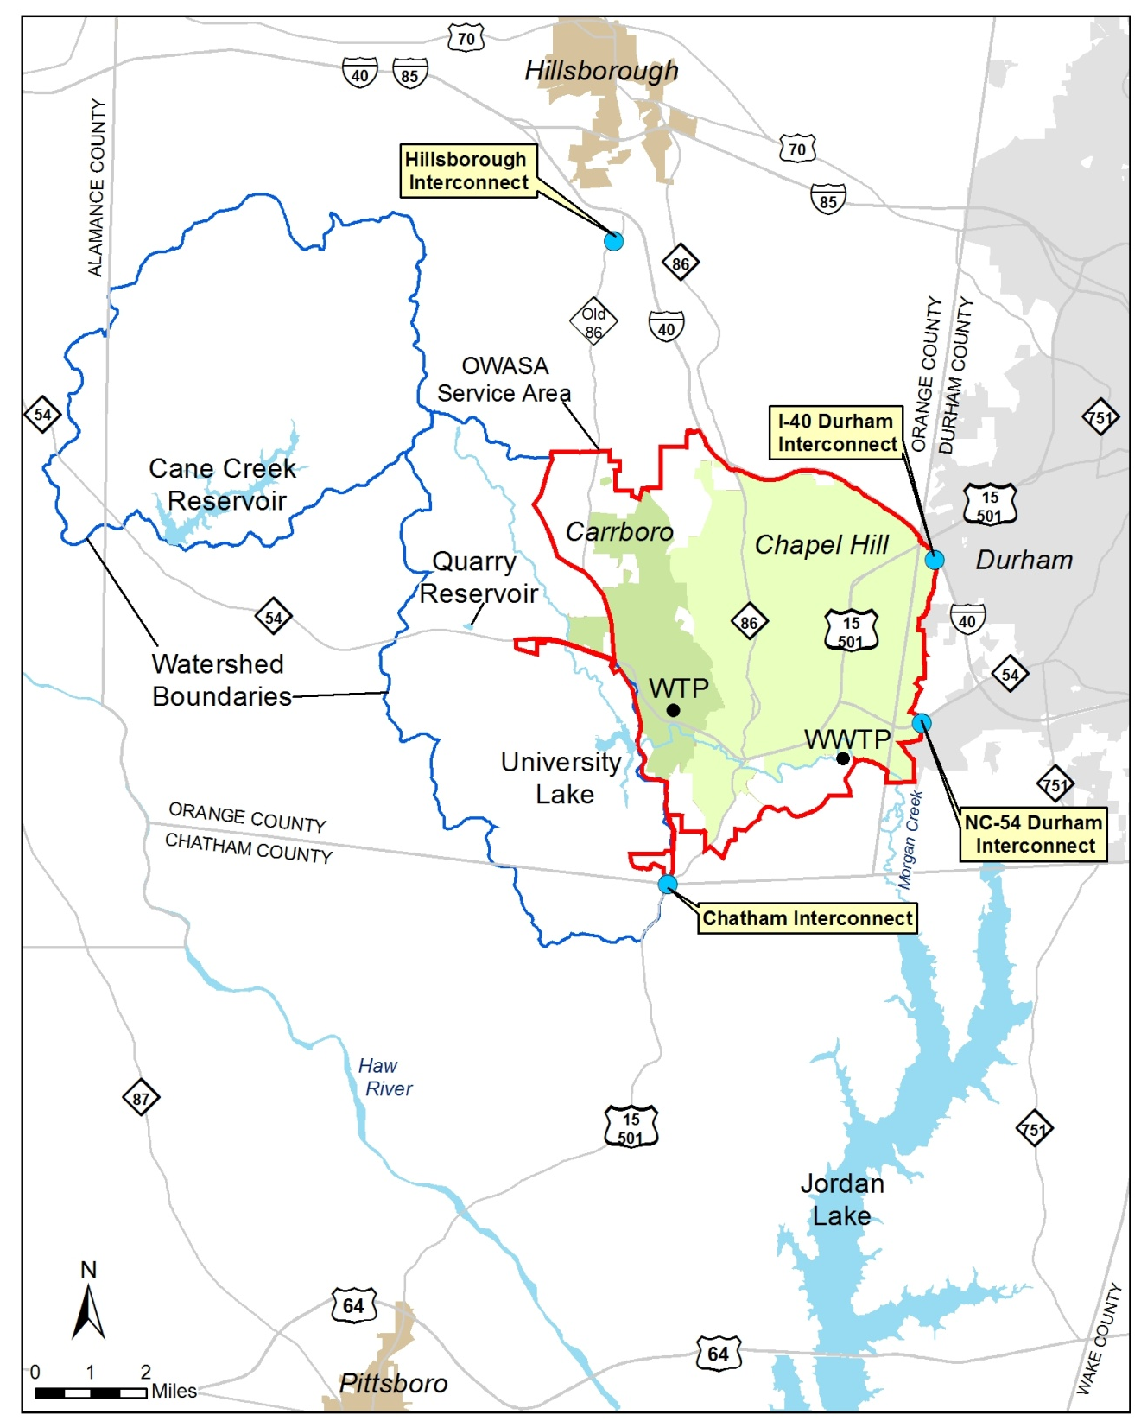
Water Supply
University Lake
Cane Creek Reservoir
Quarry Reservoir
Jordan Lake (backup supply via mutual aid)
Jones Ferry Road Water Treatment Plant – 20 MGD
Reclaimed Water – 3 MGD
Emergency Interconnections
City of Durham (Cary)
Town of Hillsborough
Chatham County
Wastewater Management
Mason Farm Wastewater Treatment Plant – 14.5 MGD

Slide 5
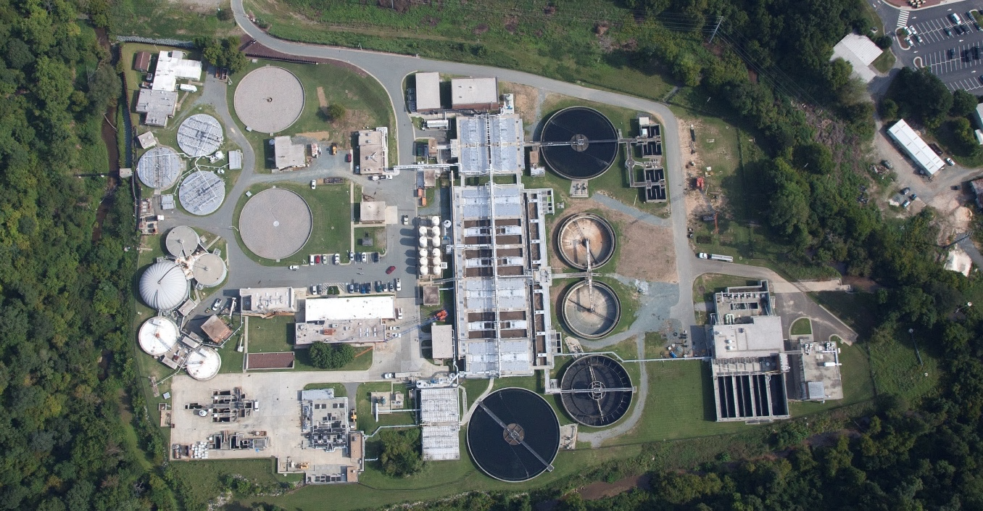
Reclaimed Water Facility
Mason Farm Wastewater Treatment Plant

Slide 6
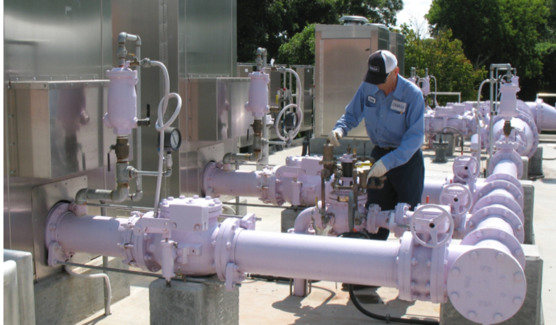
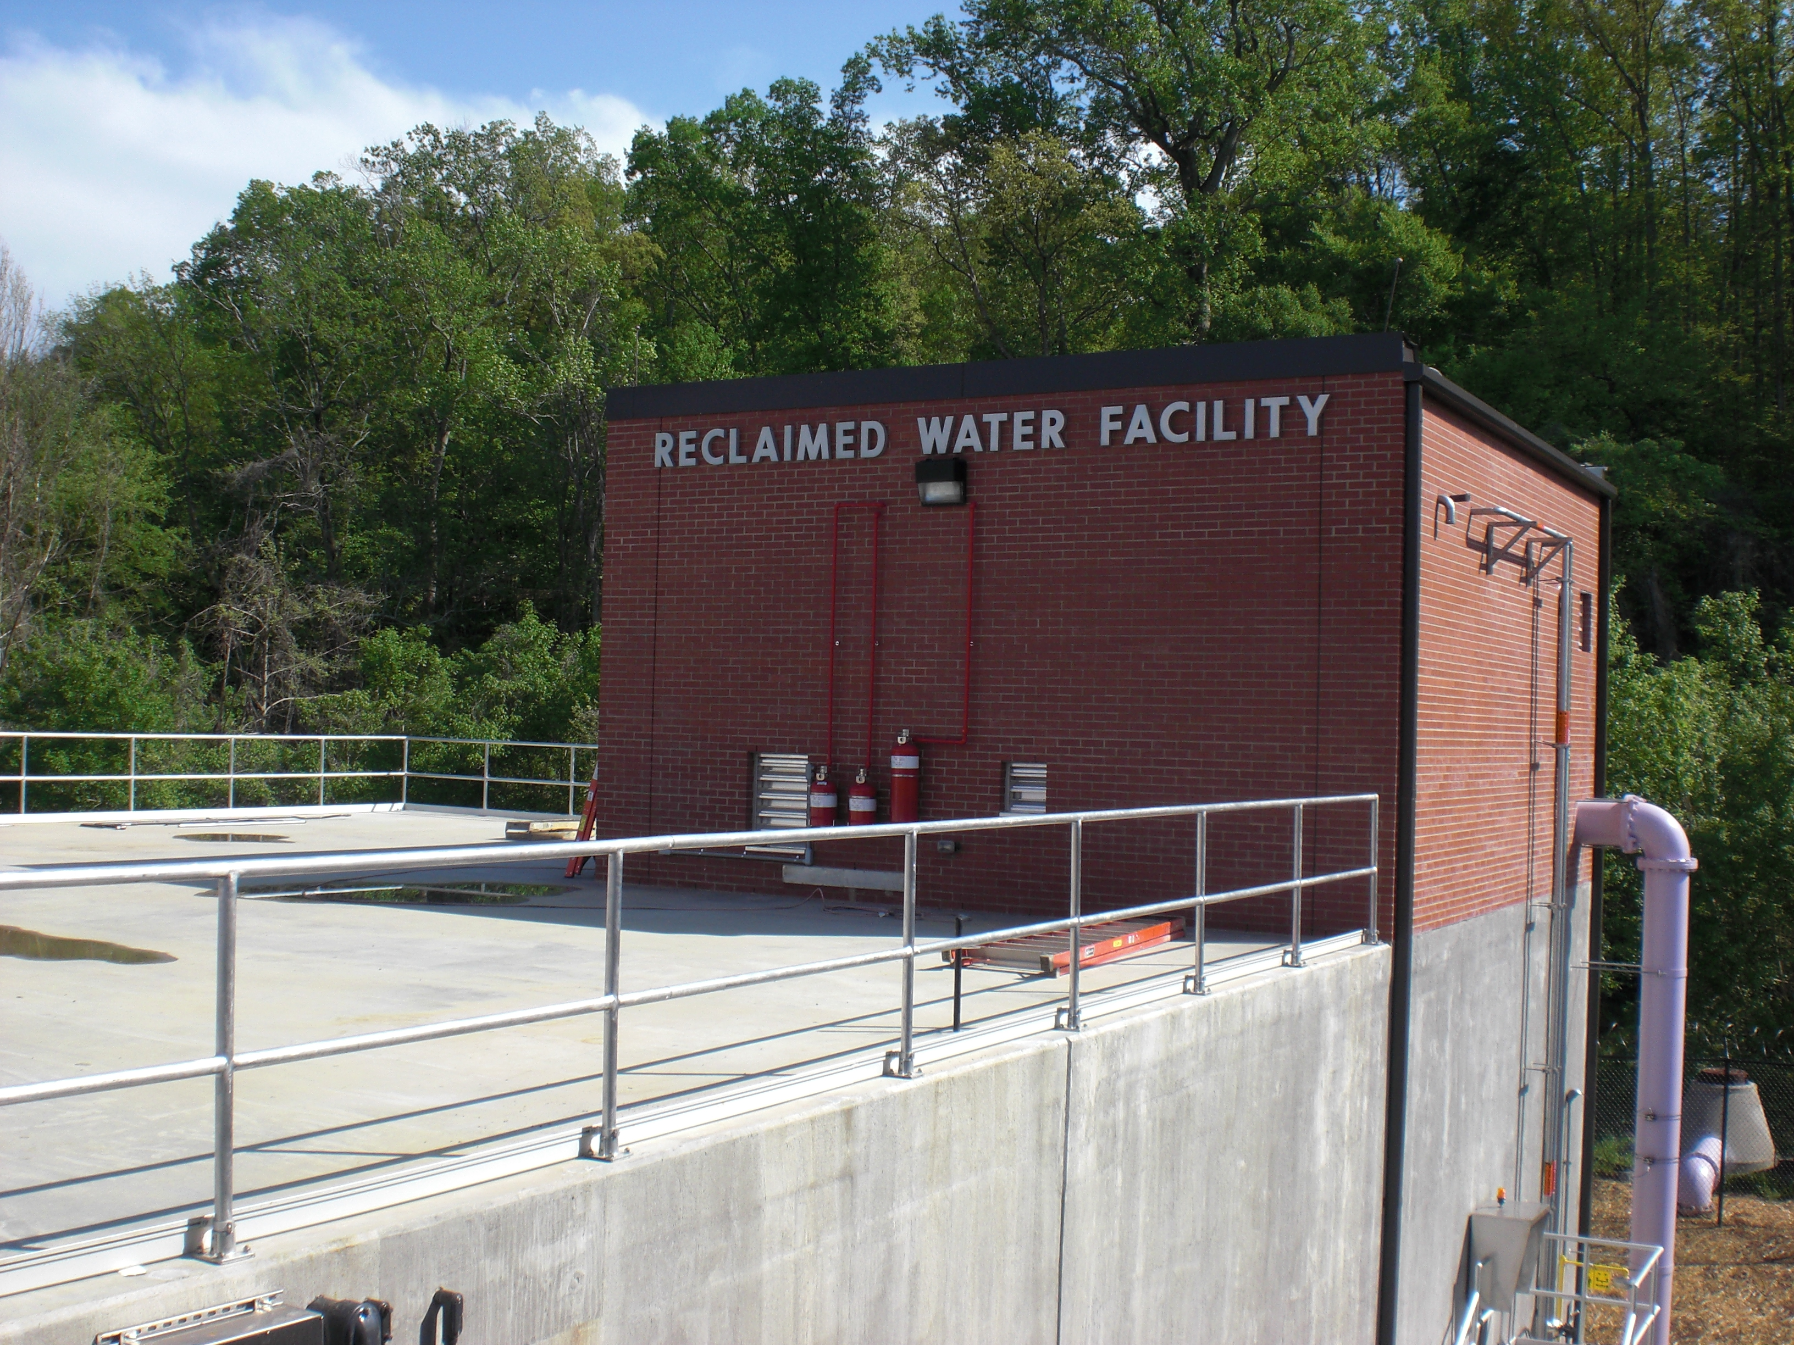
Operational 2009
Dual disinfection
UV
chlorine residual
Continuous monitoring of water quality

Slide 7
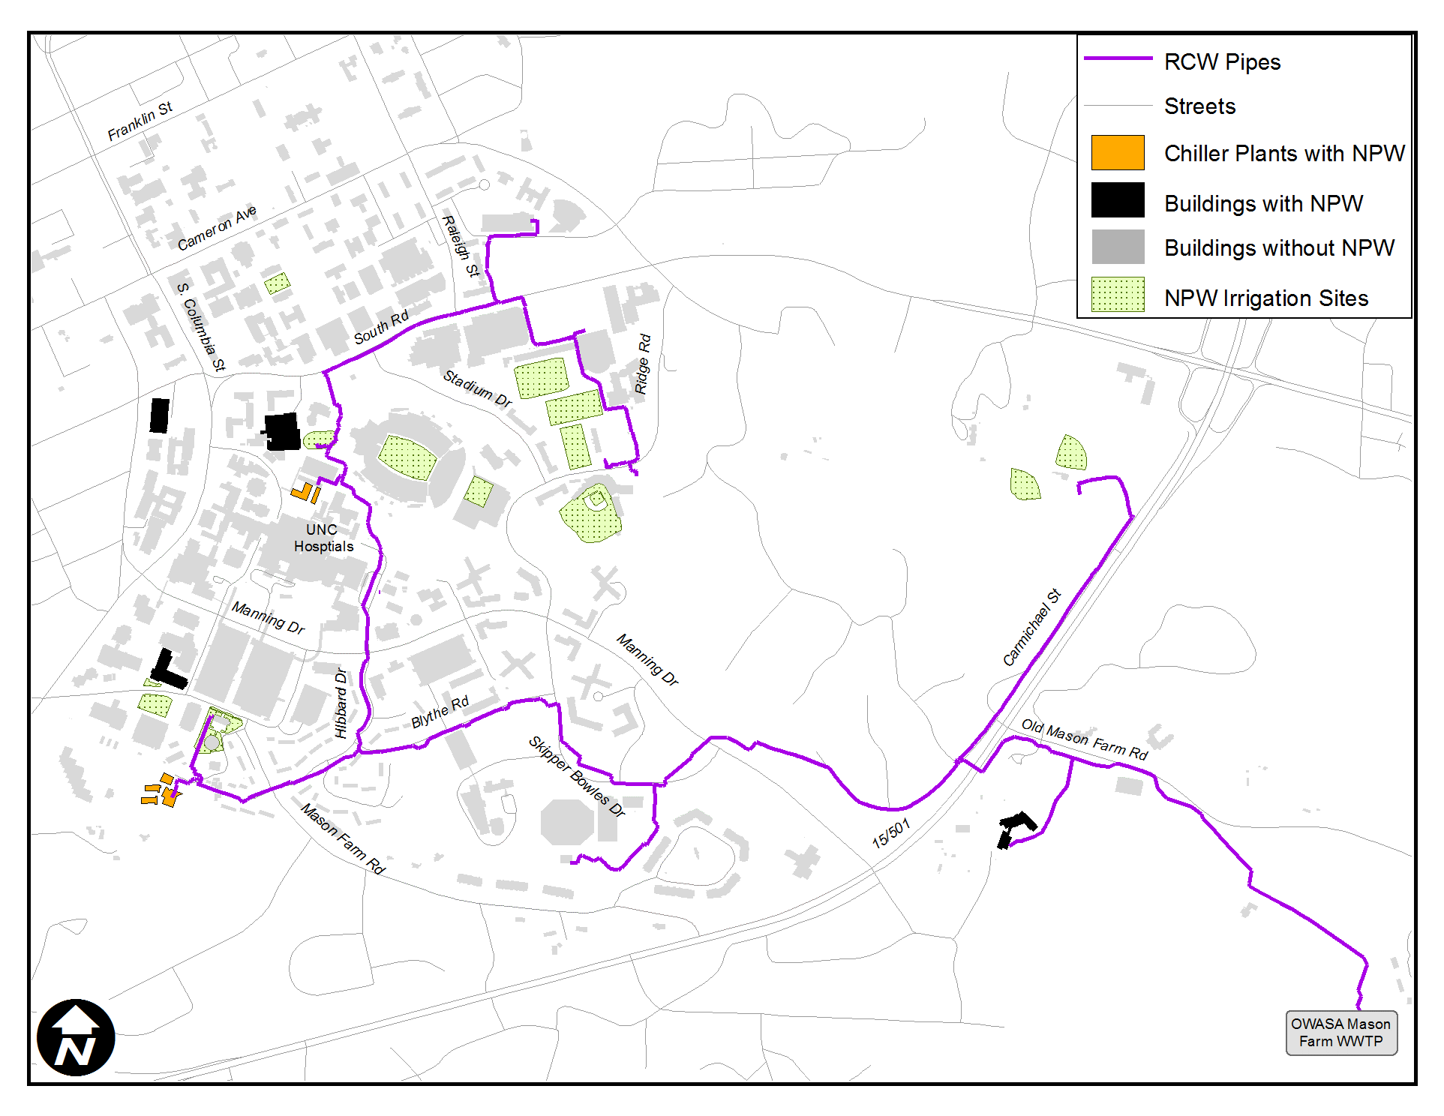


Slide 8
Total OWASA Water Use (annual average in million gallons per day)
Fiscal Year | Potable Water | Reclaimed Water | Total | Reclaimed Water as % of Total
2016 | 6.0 | 0.6 | 6.6 | 9.1%
2017 | 6.0 | 0.7 | 6.7 | 9.8%
2018 | 6.2 | 0.6 | 6.8 | 9.1%
2019 | 6.0 | 0.7 | 6.7 | 10.7%

Slide 9
Water Sales and Accounts
Reclaimed Water to UNC begins 2009

Slide 10
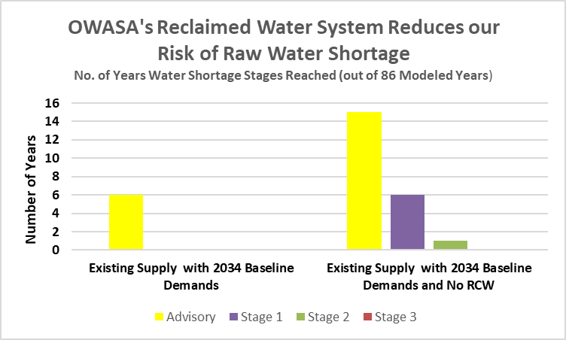
Notes:
Advisory – 2% reduction in demand
Stage 1 – 5% reduction in demand
Stage 2 – 9% reduction in demand
Stage 3 – 13% reduction in demand
Emergency – 27% reduction in demand
If hit Stage 3 last year, doesn’t mean we won’t hit it again this upcoming year
Scenario 1 – 6 years in advisory
Scenario 2 – 15 years in advisory; of those 15, in Stage 1 for 6; in Stage 2 for 1 (in mandatory – 7% of years)
Scenario 3 – 21 years in advisory; of those, in Stage 1 for 9 years; of those 9, reach Stage 2 in 3 years; Stage 3 in 1 year (10% of years in mandatory water shortage)
Scenario 4 – 38 yrs in advisory; of those in Stage 1 for 21 years, Stage 2 for 8 years, Stage 3 for 3 years (24% of years in advisory)
Scenario 3 and 4 – Scenario 3: 9 consecutive weeks in Stage 3; Scenario 4: 19 consecutive weeks in Stage 3
Drought surcharges kick in at Stage 1 for Res Blocks 3 and 4; Stage 2 for Block 2
Drought surcharges kick in at Stage 1 for MFMM, non-res, and irrigation only meters
Stage 2 could begin impacting car wash and businesses such as power washing

Slide 11

Drivers for Water Reuse (Potable and Non-potable)
Q1
Limited quantities conventional source water supplies
Challenging qualities of conventional source water supplies
Limited drinking water treatment capacity (NPR offsets potable water usage)
Limited drinking water distribution capacity
Environmental discharge limitations
Limited collection system capacity (onsite reuse)
Suitability of reclaimed water versus potable water (fit-for-purpose)
Drinking Water Perspective
Wastewater Perspective

Slide 12
Types of Water Reuse
IPR
DPR
Q1
Indirect Potable Reuse
Direct Potable Reuse
Groundwater Augmentation
Surface Water Augmentation
Raw Water Augmentation
Finished Water Augmentation
Non-Potable Reuse
Irrigation
Cooling
Toilet flushing
Bulk fill
Boiler feed
Refineries
Wetland restoration
Washdown
Seawater intrusion barrier
Groundwater replenishment
Aquifer storage and recovery
Reservoir supplementation
WWTP pipe-to-WTP intake
WWTP pipe to advanced treatment to water distribution system

Slide 13
Current Uses of OWASA’s Reclaimed Water
IPR
DPR
Q1
Indirect Potable Reuse
Direct Potable Reuse
Groundwater Augmentation
Surface Water Augmentation
Raw Water Augmentation
Finished Water Augmentation
Non-Potable Reuse
Irrigation
Cooling
Toilet flushing
Bulk fill
Boiler feed
Refineries
Wetland restoration
Washdown
Seawater intrusion barrier
Groundwater replenishment
Aquifer storage and recovery
Reservoir supplementation
WWTP pipe-to-WTP intake
WWTP pipe to advanced treatment to water distribution system
OWASA Uses

Slide 14
Updating OWASA’s Long-Range Water Supply Plan
IPR
DPR
Q1
Indirect Potable Reuse
Direct Potable Reuse
Groundwater Augmentation
Surface Water Augmentation
Raw Water Augmentation
Finished Water Augmentation
Non-Potable Reuse
Irrigation
Cooling
Toilet flushing
Bulk fill
Boiler feed
Refineries
Wetland restoration
Washdown
Seawater intrusion barrier
Groundwater replenishment
Aquifer storage and recovery
Reservoir supplementation
WWTP pipe-to-WTP intake
WWTP pipe to advanced treatment to water distribution system
OWASA Uses
Being Evaluated

Slide 15
Indirect Potable Reuse
Q1
Surface Water Augmentation
Groundwater Augmentation

Slide 16
Direct Potable Reuse
Q1
Finished Water Augmentation
Raw Water Augmentation

Slide 17
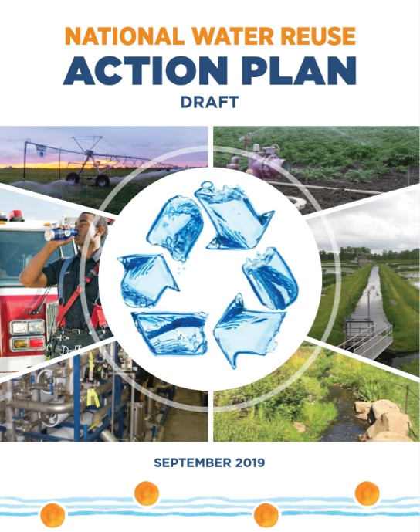
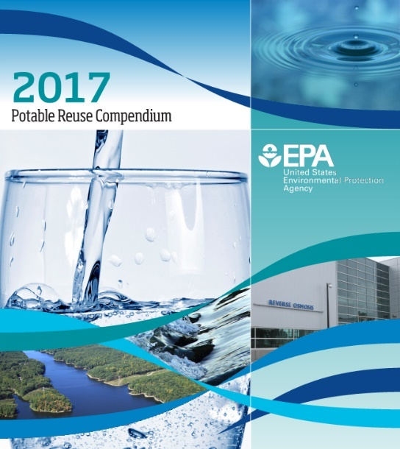
Regulating Water Reuse: Federal Regulations & Guidelines
Q1
The SDWA and the CWA provide a foundation from which states can further develop and support potable water reuse as they deem appropriate.
Action Plan Action 2.3.2: Develop Frameworks for Public and Environmental Health Risk-Based Targets
EPA References: 2012 Guidelines for Water Reuse
2017 Potable Reuse Compendium
2019 National Water Reuse Action Plan (Draft)
Notes:
Although EPA encourages an integrated approach to water resources management, it does not require or restrict practices such as water reuse.
EPA acknowledges the primacy of states in the allocation and development of water resources.

Slide 18
Regulating Water Reuse: State Regulations & Guidelines
Q1
North Carolina
Potable reuse is allowed due to 2014 legislation (Senate Bill 163), but no existing regulations in North Carolina
NC
NC
The General Assembly finds that the use of reclaimed water to supplement source waters for potable water treatment is an appropriate and prudent measure in regions of the State with limited water resources under limited conditions, if:
Reclaimed water discharge isn’t required for environmental flow limitations
Reclaimed water and source water are combined in a pretreatment mixing basin
Mixing basin is completely mixed, sized for 5 days’ storage
Reclaimed water meets Type 2 water quality requirements (“the highest reclaimed water effluent standards established by the Commission”)
Reclaimed water is 20% of stored volume, at a maximum
Evidence of need is provided (e.g., implemented conservation, alternatives analysis, etc.)
Finished potable water supply meets Federal and State requirements
Any discharge into waters of the State must be pursuant to a permit issued under G.S. 143-215.1
N.C. Gen. Stat. § 143-355.5; 15A N.C. Admin. Code 02U

Slide 19

EPA – Water Reuse Action Plan
EPA supports water reuse as part of an integrated water resources management approach developed at the state, tribal, watershed, and local level to meet multiple needs. An integrated approach commonly involves a combination of water management strategies and engages multiple stakeholders and water needs.

Slide 20
Key Takeaways
Water reuse is an essential part of a “One-Water” management strategy
Science-based regulations should support and encourage water reuse. Reclaimed water is a resource, not a “waste”.
Existing NC regulations allow smart use of non-potable reuse
Opportunity to adopt science-based regulations in NC to support and encourage indirect and direct potable reuse – site specific considerations (flexibility)

Slide 21
Ed Kerwin
Executive Director
ekerwin@owasa.org
919-537-4211
Monica Dodson, Wastewater Treatment and Biosolids Recycling Manager
mdodson@owasa.org
919-537-4205
Orange Water and Sewer Authority
OWASA is Carrboro-Chapel Hill’s not-for-profit public service agency delivering high quality water, wastewater and reclaimed water services.
919-968-4421 OWASA 24 hours

Slide 22
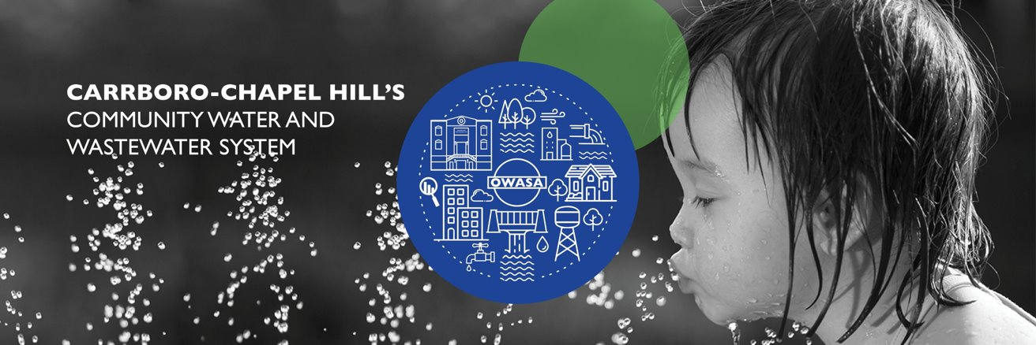
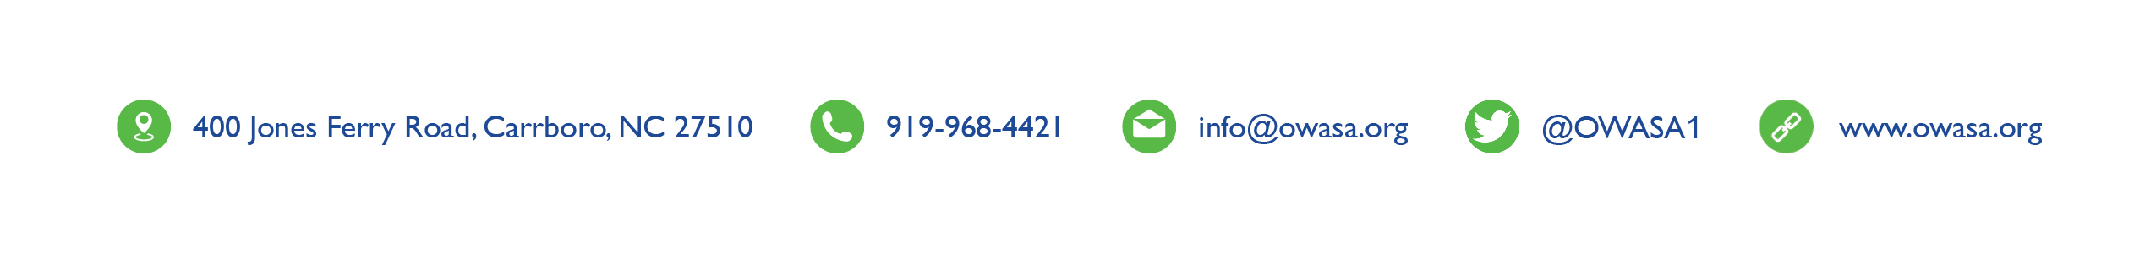
Notes:
This presentation has highlighted a few of the improvements OWASA is working on to ensure safe and reliable drinking water to the community.
More information can be found on our website at owasa.org
I’d be happy to answer any questions you may have at this time.

